Slide 1

Global Access to Primary Education
Data Analysis & Statistical Overview
Presented by:-
Krish Yogesh Prajapati
Shravani Harel
Aneek Chowdhury
Ali Azim
Jijabai Mahadeo Shejale
Machine Learning Group Project

Slide 2

Project Objective
Understand Global Education Access Patterns
Statistical Analysis & Quartile Interpretation
Country-Level Comparative Analysis
Educational Inequality Assessment

Slide 3
Dataset Overview
Source: Kaggle.com
Access to primary education across different countries
https://www.kaggle.com/datasets/willianoliveiragibin/access-to-primary-education
Total Records: 815 observations across multiple countries
Time Period: Historical data spanning decades of educational access, also predicting for future years
Analysis Focus: Global literacy and basic education patterns

Slide 4
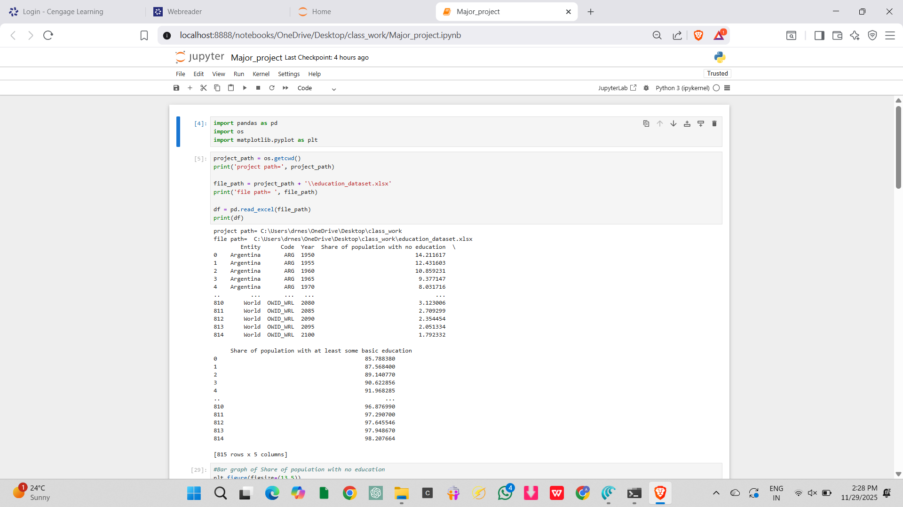
Dataset
Targeted dataset for our data visualization

Slide 5
Research Questions
What is the global distribution of basic education access?
How do literacy rates vary across different countries?
What are the key statistical measures (quartiles, median, outliers)?
Which countries lead in educational access?

Slide 6
Data Preparation & Loading
Imported required libraries:
pandas: Supports reading or writing data from various CSV, Excel etc. files.
matplotlib: Used for data visualization and graph plotting
Loaded dataset from Excel file using pd.read_excel()

Slide 7
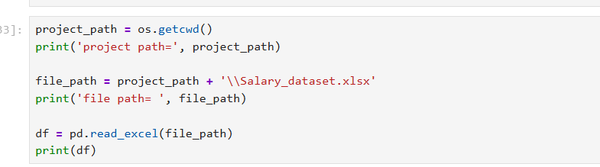
Reading Excel Data into Jupyter Notebook
Through this code, we include the dataset into jupyter notebook along with file path and project path for further processes, coding and calculations.

Slide 8
Output

Slide 9
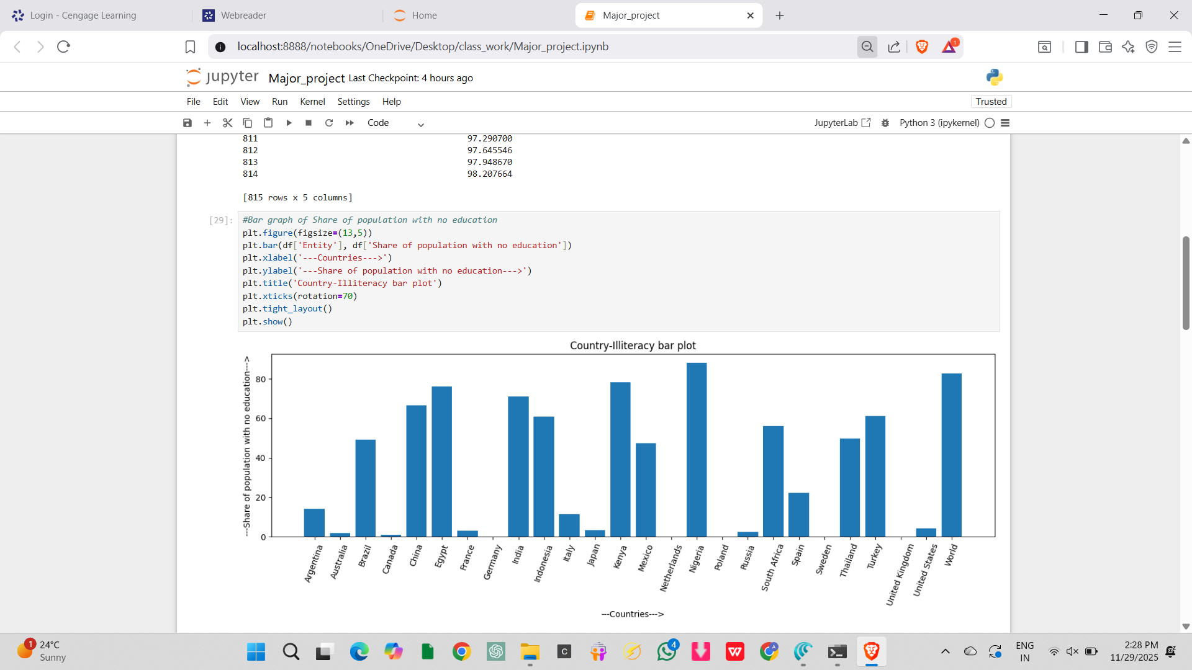
Bar Graph plotting of population with no education

Slide 10
Continued..
plt.bar() — Creates a bar chart to compare values across categories (countries)
plt.xlabel() — Sets the label for the x-axis
plt.ylabel() — Sets the label for the y-axis
plt.title() — Adds a title to the plot
plt.xticks(rotation=70) — Rotates x-axis labels for better readability
plt.tight_layout() — Automatically adjusts subplot spacing to prevent label cutoff, or presents the graph clearly

Slide 11
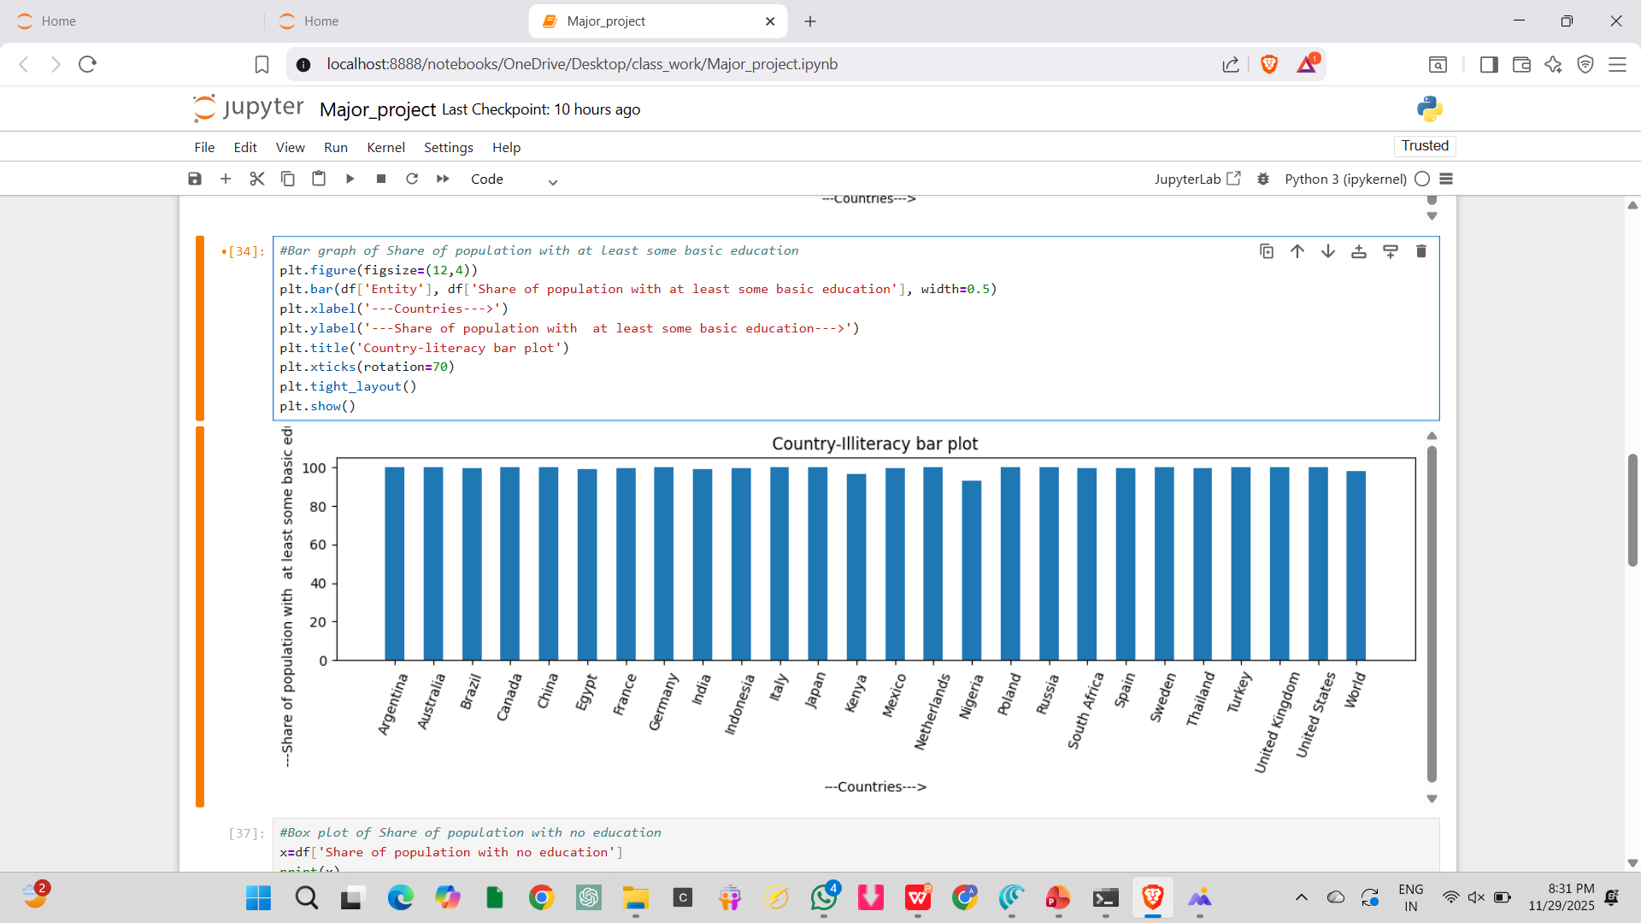
Bar graph of population with at least some basic education

Slide 12
Global Literacy Bar Chart Analysis
High Performers: Most developed nations exceed 90% literacy
Mid-Range: Emerging economies show 60-80% access
Developing Nations: Some countries below 50% basic education
Trend: Strong positive correlation with economic development

Slide 13
Box plotting
A box plot displays the distribution of data using quartiles, showing how data is spread across the range. It reveals median, spread, and outliers.
Box: Contains the middle 50% of data
Whiskers: Show the range of typical values
Outliers: Individual points beyond the whiskers

Slide 14
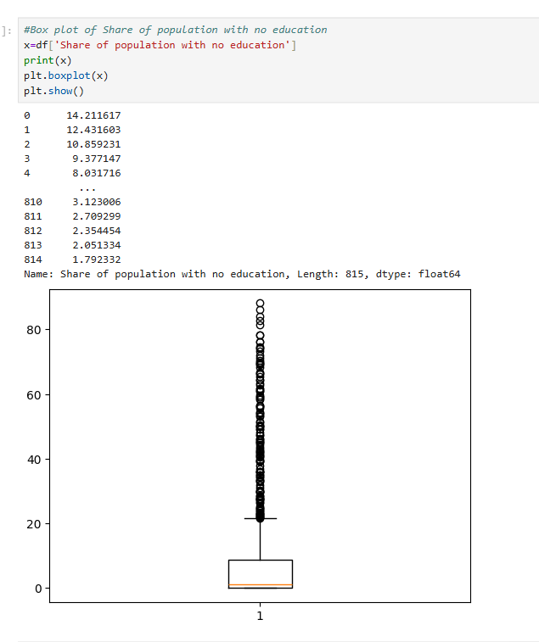
Box plot of population with no primary education
Median (Q2): ~8-12% — Central tendency shows typical percentage without basic education
Q1 (25th percentile): ~2-3% — Lower quartile: 25% of countries have below 3% uneducated population
Q3 (75th percentile): ~20-25% — Upper quartile: 75% of countries have below 20-25% without education
Around 10% of the total population have had no primary education

Slide 15
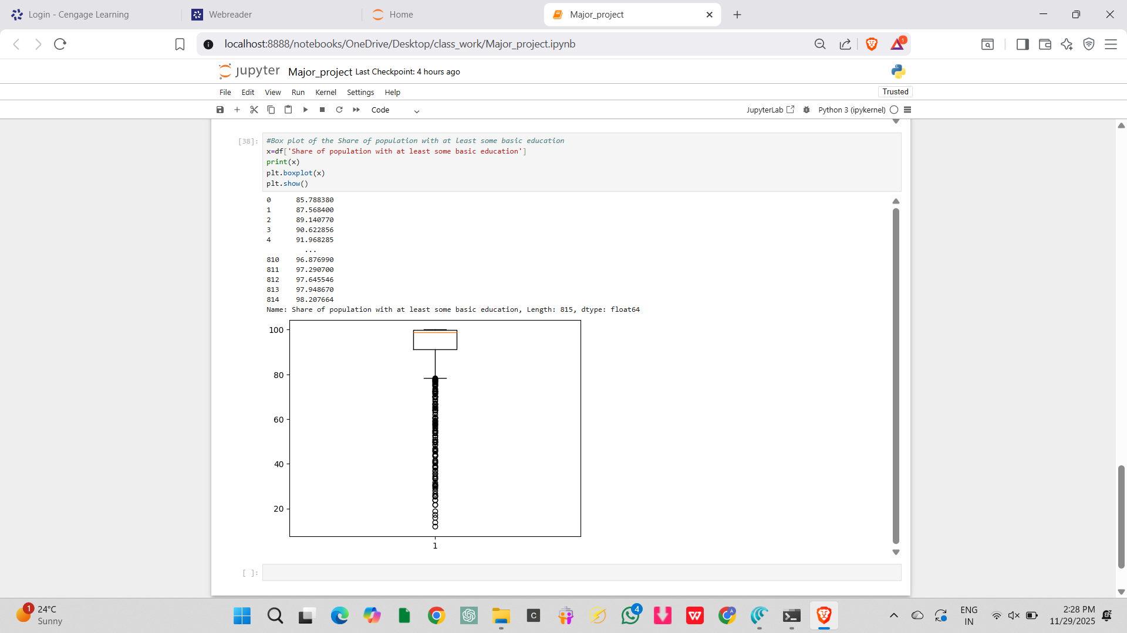
Box plot of population with at least some primary education
Median (Q2): ~90% — Most countries have achieved 90% basic education access
Q1 (25th percentile): ~85% — Lower quartile shows 25% of countries below this threshold
Q3 (75th percentile): ~96% — Upper quartile shows 75% of countries exceed 96% literacy
90% of the targeted population have at least some basic education

Slide 16
Thank You!
This Project was made under the guidance of Sir Vikas Goel, for which we are highly grateful to him.

